Slide 1
How to write a good technical report？
Ling Liu
liulingcs@szu.edu.cn

Slide 2
How to write a good technical report
Before writing the first word:
Make your mind regarding the message you want to convey.
Try to define the likely audience:
Technical audience
Non-technical, e.g., general public
Taking into account the audience’s limitations and the message you want to convey, choose an appropriate outline.

Slide 3
Components(not in order)
Executive Summary
Introduction
Methodology
Results/Analysis of
Conclusion
Bibliography
References
Abstract
Background
Appendices
Figure and Tables
…
Notes:
Executive Summary 执行纲要

Slide 4
Executive Summary
A summary, tailored to high level executives outlining the major findings of the report, i.e., the bottom line. Standalone, not part of main document.
Abstract
A summary of major research/methodological contributions. Used in research papers and documents.

Slide 5
Background
A description of the history behind that particular problem. It may cover previous works on the area and previous attempts to solve the problem.
Introduction
A transition toward the main body of the document. It should take an uninformed reader from a level of zero-knowledge to a level in which the reader is able to understand the main body of the document.

Slide 6
Introduction -components
A good introduction must have:
motivation (i.e., why is it important)
General
Specific
Background (i.e., what is the history of this issue?)
Objective (i.e., what are you trying to accomplish?)
Scope (i.e., what is the focus of your analysis?)
Limitations (i.e., what constraints did you face?)
Content (i.e., what is in the report?)
Organization ((i.e., how the report is organized?)

Slide 7
Methodology
A description of the methodological framework you have used in the project, or investigation. It focuses on the theoretical side of the methods.
Analysis of Results
A description of the results obtained and analysis of the implications associated with main results. It must be supported by figures and tables to facilitate, not to confuse, the reader.

Slide 8
Conclusions
A summary of the major findings you have arrived to in the previous sections. “Conclusions” is not an analysis section.
Recommendations
Insights into the next steps you recommend to be taken. This must be supported by the analysis and conclusions section of the report.

Slide 9
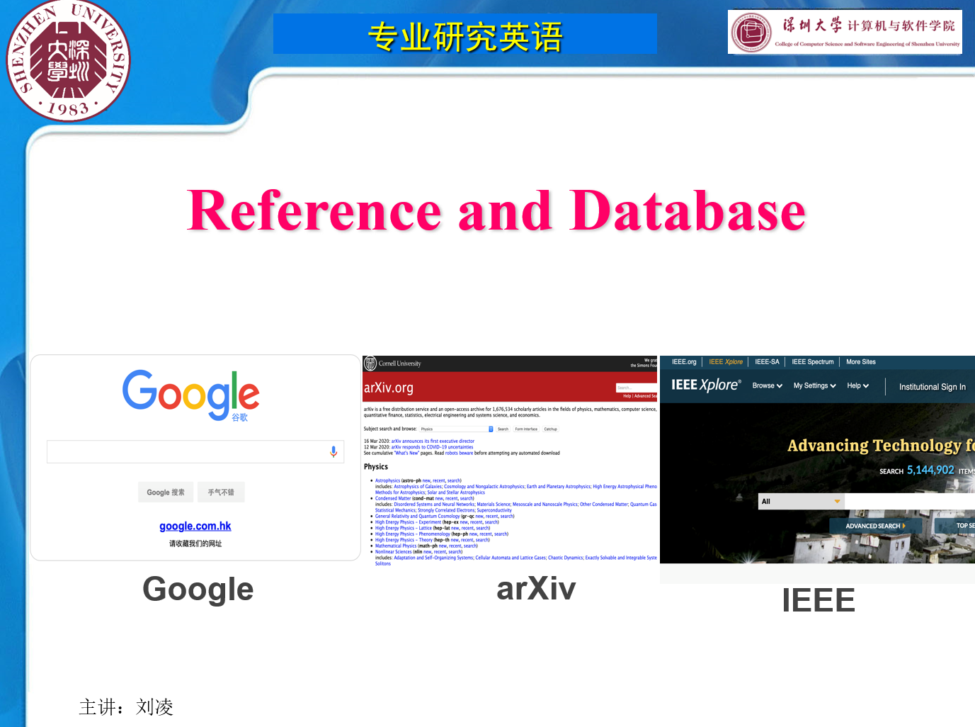
Bibliography & References
A listing of books and articles you have used, or consulted, for methodological and non-methodological issues.
Must follow the IEEE citation style, which has been introduced in this class.

Slide 10
Figures and Tables
They are intended to facilitate understanding of the document by presenting relevant information and data in a easy-to-understand-way. They must be integrated to the main body.
Appendices
Intended to present data and analysis, that though important, may not be directly relevant to the main body. It is intended for interested readers only. Appendices are not dump places and they must be classified and organized.

Slide 11
Typical outline
Full blown report
Executive Summary (1)
Abstract (2)
Introduction (3)
Background (4)
Methodology (5)
Analysis and Results (6)
Conclusion (7)
Recommendation (8)
References and Bib. (9)
Appendices (10)
Figures and tables (11)

Slide 12
Notes you may find helpful:
(1) and (2): not always needed.
(3): although not always a section entitled “Introduction” is needed (e.g., in short reports), an introductory section (e.g., a couple of paragraphs) is always required.
(4): required when the history of the problem (or methodology) is long. Otherwise, include as part of the introduction.

Slide 13
Notes -cont- :
(5) and (6): Must be separate sections when they are relatively long. Otherwise describe (5) before (6) in the same section.
(7): Must follow from the main body (must be supported by it).
(8): If short, put at the end of conclusions.
(9): Use one or the other.

Slide 14
Notes -cont- :
(10): It must be classified and organized to present important data/information not directly relevant to the main body of document.
(11): Must be integrated to main body of document, figures and tables must be placed after they are first referenced. If no reference is made to a figure or table, why did you put it in the main body?

Slide 15
Practical instructions
Typically, survey papers include a lot of references (at least dozens, sometimes even over a hundred)
However, on this course it would be sufficient to choose 5-10 relevant papers on the selected topic as reference
The paper should be written in academic style
Template will be provided
The length about 1500-2000 words if written by one student, 2500-3000 words if written by two students jointly.

Slide 16
Q and A
Submission deadline 29. June

